Slide 1

Architectural Styles
The Bricks

Slide 2
Who are you?
Software Developer for 20 years
Worked mainly for ISVs
Reuters, SunGard, Misys, Huddle
Worked for a couple of MIS departments
DTI, Beazley
Microsoft MVP for C#
Interested in OO, SOA, EDA,, Messaging, REST
Interested in Agile methodologies and practices
No smart guys
Just the guys in this room

Slide 3

Intelligent collaboration for the Enterprise
The #1 SharePoint alternative in the cloud

Slide 4
Architectural Styles
From Mud to Structure

Slide 5
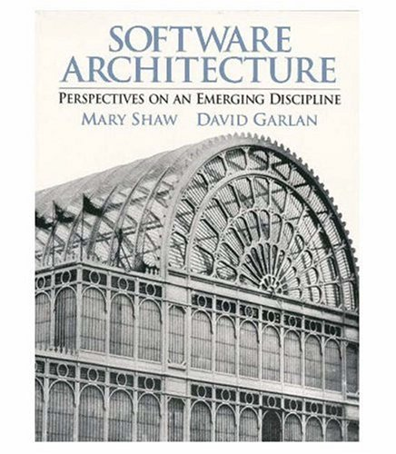
Garlan and Shaw
Working at Carnegie-Mellon in the ‘90s Shaw and Garlan begin identifying architectural styles.
Shaw and Garlan propose that the journey from craft to engineering is the creation of a body of knowledge that allows repeatable large scale production. Science provides the insights here that drive engineering.
Similar goal to the Design Patterns community – but at a different scale, capture knowledge on patterns of component interaction.

Slide 6
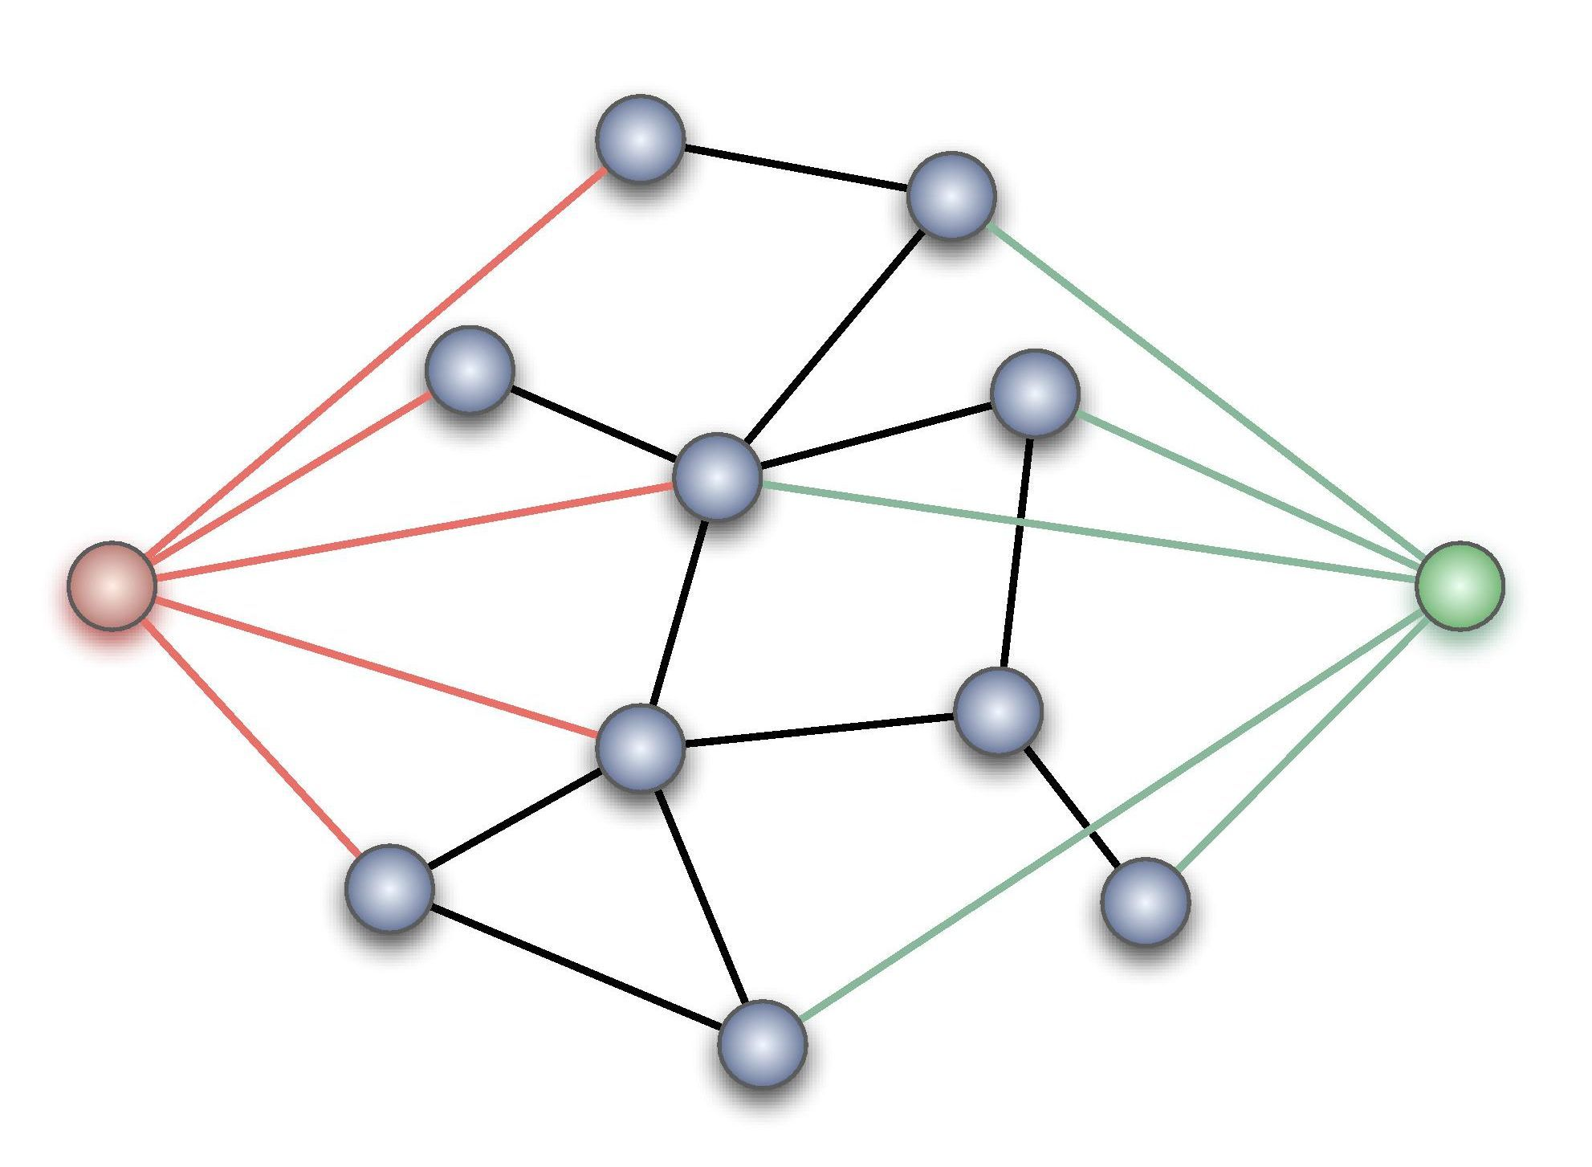
What is an architectural style?
A component is a basic architectural computational component – clients, servers, filters, layers, a database etc.
A connector provides the interaction between components.
A style is a vocabulary of possible components and connector types, and constraints on how they can be applied.
Given the above we can classify architectures:
What is the design vocabulary?
What are the allowed structural patterns?
What is the underlying computational model?
What are the essential invariants?

Slide 7
Boxology
Data Flow | Dominated by movement of data through the system, with no “upstream” content control by recipient | Pipes and Filters Batch Sequential
Data Centered | Dominated by a complex central data store manipulated by independent components | Repository Blackboards
Data Sharing | Dominated by sharing of data amongst components | Hypertext Systems Compound Document
Call & Return Systems | Dominated by order of computation, usually with a single thread of control | Procedural Object Oriented Naïve Client Server
Interacting Processes | Dominated by communication between independent, usually concurrent, processes | Event Driven (Implicit , Reactive, or Decoupled Invocation) Event Sourcing Broker SOA
Hierarchical Systems | Dominate by reduced coupling with the partition of the system into subsystems with limited interaction | Interpreters Rule-Based Systems Layers CQRS
Missing from this is obviously any discussion of User Interface styles. The question is whether MVC, for example, is simply a design pattern that fits into another one of these styles or has unique characteristics

Slide 8
Heterogeneous styles
Components
Connectors
Whilst we talk about styles in a pure form for understanding, most applications employ a combination of styles
The most common approach is hierarchical – a component identified in one style is itself implemented using another style
A single component might use different architectural connectors. A component might access a repository, but interact with other components through pipes and filters or implicit invocation
Elaborate a whole level of the architecture in a different style (as opposed to just a component)
A connector may be hierarchically decomposed as well
For example the pipe in a pipes and filters architecture might be implemented using messaging middleware, which is itself uses a heterogeneous architectural style such as repository and implicit invocation

Slide 9
Candidate model problems
How do we decide on the properties of a software architecture

Slide 10
Candidate Models
The models
Intended as a set of sample problems to allow comparison of the solution in different architectural styles.
The idea is that as the problems become well-known then discussion of proposed new architectures can dispense with a description of the problem and proceed to discussion of the solution
Because architectural styles are solving well-known problems, with well known properties comparison of the fitness of architectural styles becomes easier.
Keyword in Context (KWIC): Given a set of lines, create an alphabetized list of the rotations of those lines.
Sea Buoy: Collect and transmit weather data both automatically and on demand; allow preemption for emergency services.
Cruise Control: Maintain the speed of a vehicle.
Conference Refereeing: Solicit, referee, and select papers for a conference.
Mailing List Handler: Merge address information from multiple sources, eliminating duplicates and observing reader preferences.
Printer Spooler: Manage print jobs within a printer network.
Library: Automate traditional library tasks, such as check-in and check-out of books.
Automated Teller Machine (ATM): Provide the usual banking functions with a remotely-located machine.
Calendar Scheduler: Organize a meeting schedule.
Compiler: Translate source code for a programming language to executable form.
Mobile Robot: Design a mobile robot capable of executing tasks while monitoring the environment, e.g., avoiding obstacles.

Slide 11
KWIC
Keyword in Context originally proposed by Parnas to illustrate advantages of different designs [Parnas72]
For a text, a KWIC produces a permuted index
Every sentence is replicated and permuted in its words i.e. shift from left to right
Every first word of a permutation is sorted alphabetically and entered into the index
The KWIC system accepts an ordered set of lines
Each line is “circularly shifted” by repeatedly removing the first word and appending it to the end of the line
The output of a KWIC system is a listing of all circular shifts of all lines in alphabetical order

Slide 12
Dataflow Styles

Slide 13
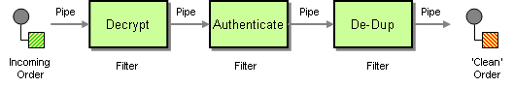
Pipes and Filters
Drivers
Need to process or transform a stream of data.
The task decomposes into steps.
The small processing steps are easier to re-use in new contexts than larger components.
The small processing steps are easier to test in isolation than within the whole.
Non-adjacent steps do not share information.
Explicit processing of steps by users is error prone.
We want to be open to extension but closed to modification.
We want multiple developers to work on the solution.
Steps may need to be run in parallel.

Slide 14
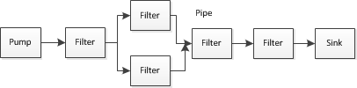
Pipes and Filters
Each component has an input and output. It reads a stream of data on the input and writes it on the output.
It applies a transformation to the input stream and writes it to the output stream. It applies the transformation incrementally, so that output begins before input is consumed. Hence the components are called filters.
The input is provided by a source or pump and flows into a sink. A file is a common example of both
The connectors serve as conduits for a stream of data, and thus are called pipes.
In a pipeline the topology is restricted to a linear sequence. In a bounded pipe, the amount of data in a pipe is restricted. In a typed pipe the data passed between two types is a well-defined type.

Slide 15
Invariants
Properties
Filters must be independent of each other.
A filters does not know the identity of the upstream or downstream filters from itself.
A specification may guarantee what is on an input pipe, and constrain what goes onto an output pipe, but not identify the filter.
Allow reasoning about the system as a composition of simple to understand components.
A filter can be re-used by being composed into new pipelines
New filters can be easily added, and old filters replaced
Filters are separate tasks and potentially parallel to each other.
Rapid prototyping by reusing existing filters

Slide 16
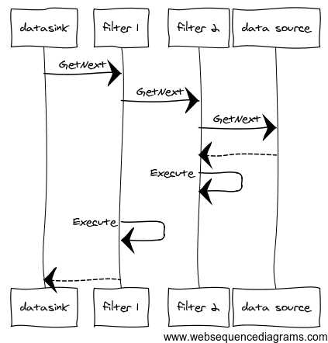
Pull pipeline
The data sink of each pipeline pulls data from upstream. In other words the end of the line initiates processing by pulling down from the source
Example: Any LINQ pipeline

Slide 17
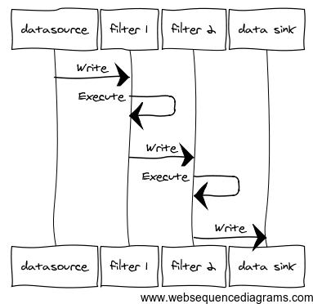
Push Pipeline
The data source pushes to the next components in the line. In other words the data source initiates processing by pushing to subsequent components
Example: An RX pipeline

Slide 18
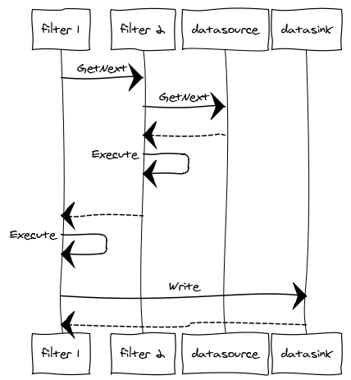
Push and Pull Pipeline
In this approach we combine both push and pull. We pull from a data source but we push to a data sink

Slide 19
Implementation
Divide the system’s task into a sequence of processing stages
A stage must depend only on the output of its predecessor
Define the data format to be passed along the pipe
UNIX uses line-structured ASCII text
Decide what represents ‘end-of-input’ so we know not to process further elements of that stream
Important not just for sink but for filters that must process all the stream –such as sorting – before passing on to their neighbour
Decide how to implement the pipe
How does the filter communicate with adjacent filters? The main choice here is between push and pull. Sometimes we talk about active filters, which control the process, and passive filters which only respond to an active filter.
Does the filter perform a direct call to the next filter, or does a separate pipe component control the sequencing of filters? The former is easier to implement, but the latter increases the flexibility for recomposing the pipeline as no modifications are required to the filter itself.
Decide how to implement the filters
A sequence of filters can be in-process or use multiple processes. An in-process component is the easiest to deliver and get under test. Multiple processes are easier to parallelize.
To parallelize an in-process pipeline requires separate threads for each filter, and concurrent queues for the pipe.
Multiple processes are inherently parallelized by the OS; they use middleware such as a message queue for the pipes.
To further parallelize use the competing consumer pattern that allows us introduce multiple instances of a filter, all consuming the same channel, and writing to the same channel. This may be easier with multiple processes as there is no need to deal with threading explicitly, instead relying on the OS to schedule.
Decide on error handling
A difficult question is how to notify errors from within the pipeline?
This can be easier in-process – just throw an exception that the pipeline initiator can catch to indicate an issue with the pipeline
UNIX uses a stderr pipe to report errors
Pipes and Filters may be implemented both in-process, using an in-memory pipeline, or as a distributed system using a message channel between independent processes that act as the filters.
Benefits from parallelization can be harder to realise than at first-glance. For example a sort filter has to read all the input, up to the end of stream marker, before it can sort.

Slide 20
Examples
Disadvantages
Unix commands (stdin, stdout, stderr – everything is a file)
Document and Image processing
Encourage a ‘batch’ system approach as each component must process data independently
Poor at handling UI
Dependency on order of filters
Error handling difficult – what happens if an intermediate filter crashes
Incremental approach creates design challenges over batch approach (see batch-sequence)

Slide 21
Batch Sequence
Drivers
History
You have discrete tasks of a predetermined form, that occur at periodic intervals of time. For example you need to create over-night reports
The task decomposes into steps.
Each step runs to completion before the next step begins
The small processing steps are easier to re-use in new contexts than larger components.
The small processing steps are easier to test in isolation than within the whole.
Explicit processing of steps by users is error prone.
We want to be open to extension but closed to modification.
We want multiple developers to work on the solution.
We want to control when processing occurs to throttle access to shared resources. In particular we may want to prioritize interactive work over batch work
Mainframes with magnetic tape made extensive use of batch processing: data passed from one step to another is stored on tape.
An example model is: Validate the transactions on an input tape to an output tape; sort the valid transactions into timestamp sequence from that input tape to an output tape; update a store with the sorted transactions from the input tape and output the modified records; read the modified records output tape, and output a report
Hadoop uses a batch-sequence architecture to deal with big data. At the scale of hundreds of gigabytes or petabytes input data will not fit on a hard drive or in memory, so information needs to be distributed to multiple machines, and process work in parallel

Slide 22
Batch Sequence
Each component has an input and output. It reads a stream of data on the input and writes it on the output.
It applies a transformation to the input stream and writes it to the output stream.
It reads the whole of the stream before processing the data (often operations like sorting and sequencing require that approach). This lowers parallelism as later stages cannot begin processing until this stage is complete; it is however often simpler to understand.
Because it reads the whole of the stream the component is usually called a step or phase.
The sequence needs to be bounded as a component needs to know when it has read the complete stream in order to process it.
The input is provided by a source or pump and flows into a sink. A file is a common example of both
The connectors serve as conduits for a stream of data, and thus are called pipes.

Slide 23
Invariants
Properties
Steps must be independent of each other.
A step does not know the identity of the upstream or downstream steps from itself.
A specification may guarantee what is on an input, and constrain what goes onto an output, but not identify the step.
Allow reasoning about the system as a composition of simple to understand components.
A step can be re-used by being composed into new batch sequences
New steps can be easily added, and old steps replaced
It may be possible to parallelize a step, and buffer inputs, but because the prior step must run to completion competing consumer models of parallelism are not possible
Rapid prototyping by reusing existing steps

Slide 24
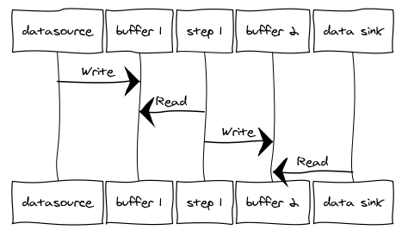
Batch Sequence
Each filter reads from its input and writes to its output. This results in a push-pull model between steps.

Slide 25
Implementation
Divide the system’s task into a sequence of processing stages
A stage must depend only on the output of its predecessor
Define how data will be exchanged between stages
This may be as simple as an in-memory bounded collection, a file or database, or messaging
The decision here is the degree of coupling that is acceptable: (tight) database, in-memory (loose) file, messaging
Decide what represents ‘end-of-input’ so we know not to process further elements in the batch
Does the step perform a direct call to the next step, or does a separate batch controller manage the steps? The former is easier to implement, but the latter increases the flexibility for recomposing the sequence as no modifications are required to the step itself.
Decide how to implement the steps
A sequence of filters can be in-process or use multiple processes. An in-process component is the easiest to deliver and get under test.
To parallelize an in-process pipeline requires separate threads for each steps, and concurrent queues for the buffer.
Multiple processes are inherently parallelized by the OS; they use middleware such as a message queue for the buffer.
Decide on error handling
A difficult question is how to notify errors from within the steps?
This can be easier in-process – just throw an exception that the pipeline initiator can catch to indicate an issue with the pipeline
Common to create a separate error output for any transactions in the batch that cannot be processed
Batch sequence may be implemented both in-process, using an in-memory pipeline, or as a distributed system using a message channel between independent processes that act as the steps.

Slide 26
Examples
Disadvantages
Compilers
Hadoop big data
Typical web-based application
Client sends request to server via HTTP
Web server reads request
Processes database queries
Renders web page
Returns HTTP response to user
Encourage a ‘batch’ system approach as each component must process data independently
Poor at handling UI
Dependency on order of filters
Error handling difficult – what happens if an intermediate filter crashes
Incremental approach creates design challenges over batch approach (see batch-sequence)

Slide 27
Demos

Slide 28
Data Centric Styles

Slide 29
Repository
Drivers
A problem with Dataflow architectures is that they are less suitable for interactive systems because they are usually eventually consistent. We may seek consistency between different operations in an interactive application and the usual approach is a shared repository.
Modifying a single large update program and a single large reporting program for each change to a transaction for each new processing request in batch processing requires retesting the whole batch.
The application consists of parts that co-ordinate their cooperation via shared data.
The application is data-driven, that is co-ordination between components is not via a specific business process but by the operation on shared data.

Slide 30
Repository
There are two types of components in a repository
A central data store represents the current state.
Independent components operate on the central data store.
If the transaction type of the input stream determines which components to activate the repository can be a traditional database. This is a passive repository.
If the current state of the central data determines which processes to execute the repository can be a blackboard. This is an active repository.
We may also identify a control component which accepts the batch or interactive transactions, synchronizes them and selects the query or update to invoke

Slide 31
Invariants
Properties
Components should be independent of each other. Coupling between components reduces modifiability.
Clients are independent of each other, and the data store is independent of the clients
The system is scalable because new clients can be added.
It is modifiable because changes made to one client need not affect other clients.
Because the repository is a shared resource it provides a limit on scalability.

Slide 32
Implementation
Divide the system into the data structure and the components that access to the data structure
The data structure defines an interface that enables components to read or write from it
The shared repository can be as simple as an in-memory database or as complex as an external data repository accessed through a data access layer
A data access layer allows the use of information hiding to prevent the application components becoming dependent on a specific data schema, supporting the modification of that schema transparently to the application components.
Separate periodic batch processing transactions from interactive transactions
Components for interactive transaction should be designed to be essentially stateless – they initialise their state by reading the database and by flushing their (modified) state at the end of the process.
A useful paradigm is:
Begin transaction
Load state from data structure
Operate on state
Flush state to data structure
End transaction
You need to synchronize between multiple updates choosing between optimistic or pessimistic concurrency models i.e. lock before writing or check state at time of writing. Alternative is ‘last one wins’.
Decide on notification between components at data structure or component level
Components can react to changes in shared data
Most database implement support for such notifications, but it is find-grained and subscribing can result in excess notifications that need to be filtered
Subscribing at the application component level, for example sing the Observer pattern
Of course the notion of a shared repository means that you integrate with other interactive components because they will read the modified data.
Decouple reporting from transaction processing
Reports remain on a periodic cycle, and often operate on stale data. Because they place load on a shared resource, reporting is usually done against an extracted database in a periodic fashion not on the transactional database.
On-line queries of stale data are not satisfactory and so are performed against the transactional store (or a buffer of that store).
Application components are typically implemented as domain objects that own a specific responsibility for accessing or maintain data in a shared repository. Co-operation between components happens solely at the level of notifications of changes to the shared repository (create, update, or delete).

Slide 33
Examples
Disadvantages
The Repository style is employed by interactive applications
Pretty much all Line of Business applications
Many consumer facing websites
Modification of the data stored in the repository can be problematic because it affects all clients who use the repository

Slide 34
Call and return Styles

Slide 35
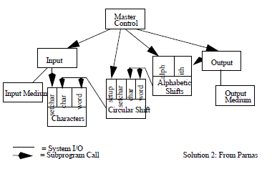
Domain Model (OO Systems)
Drivers
In call and return, each component executes when it gets control from another component and returns control when it has finished execution.
Business logic can be complex. It can be difficult for a developer to reason about software without some abstraction over this complexity. Call and return breaks the problem into small pieces to deal with complexity and help with modifiability.
Abstract data types uses information hiding to allow developers to reason about behaviours without having to understand implementation details.
If business rules involving validation, calculations, and derivations change on a regular basis then a domain model simplifies handling changes to those components. Without this logic may be duplicated across many components and hard to change. It may also be difficult to reason about where to make changes resulting in shotgun surgery. At worst we end up with a big ball of mud where it is impossible to change the system.

Slide 36
Domain Model
The components within this style are objects.
An object describes a type of resource.
Objects can be classified into instances of classes, which have attributes for querying instances states and methods for changing those states. (Command-Query Separation)
Objects support dynamic binding of methods at runtime so that calling a method or attribute on an object of class A called may result in a call to a method or attribute in a derived class B, or polymorphism.
Connectors are procedure or function invocations. Note that inheritance is not usually considered a connector because it does not define the interaction between two types
Objects are responsible for preserving invariants about a resource. For this reason objects are a manager component.
Objects are responsible for encapsulating implementation details from other objects so as to ensure loose coupling. They are an abstract data type.

Slide 37
Invariants
Properties
Components should hide implementation details from each other; sharing implementation details results in coupling which makes change hard.
Components must preserve the invariants of the resource that they manage.
Developers can reason about behaviours without having to understand implementation details. Problems can be decomposed into a set of interacting components.
Because an abstract data type collates details about related behaviour they have high cohesion and are thus easier to comprehend in isolation.
Because information hiding protects us from the implementation details we are loosely coupled. Loose coupling makes it easier to change the software as we can change implementation details without affecting other clients

Slide 38
Implementation
Identify objects within the domain
Objects are abstractions of the domain, whose roles and interactions reflect the workflow
We can identify the objects within a system using an approach like Class-Responsibility-Collaborators. CRC cards allow us to use index cards to model the interactions between objects that we need to implement a use case within the requirements
The class names form part of our ubiquitous language – a shared language used by the stakeholders when discussing the domain and expressed in the object model.
The responsibilities identify the resources this object manages and the invariants that it must preserve. The responsibilities may equate to the object’s role and be an expression of its interface.
All objects have relationships to others – the connectors – and we identify the connections for each component. Collaboration may be asymmetric.
Progress from knowns to unknowns, not top-down
Identify entities and value types
An entity is ‘compared by identity’ where its identity remains constant for its lifetime. When mapped to a relational schema and entity is typically a row with a primary key.
A value type is ‘compared by value’. It’s identity is its state, and so it is usually immutable. Changing the state results in a new instance of the class, not in a modification to the old class, so as to preserve identity.
We can also identify aggregates, or coarse grained transactional locks, that form a unit of isolation when updating a database. We can then use notifications to inform other aggregates of updates. See the Repository architectural style for more
Identify the bounded contexts within the system
A system may be too large for one domain model
As an example combining the Order and Billing system results in a domain model where objects have too many responsibilities, often conflicting. So our Customer object in the Order system may be narrowly aligned to Shopping Cart concerns, in Billing to payment, and in Shipping to location.
Identify boundaries in which invariants and rules remain narrow and aligned to purpose. Where objects that represent cognates, such as Customer, have multiple invariants for different responsibilities consider breaking the domain into separate ‘bounded contexts’
Identity how these models relate to each other via a context map
There are a number of well-known approaches to domain modelling. Noun finding is the simplest approach (with verbs as methods on those objects) which is limited but can give an initial model to iterate from. Responsibility Driven Design uses CRC as its basis, but adds techniques like stereotypes and roles. Domain Driven Design focuses on creating a ubiquitous language shared by all stakeholders, and on identifying the bounded context for that vocabulary.

Slide 39
Examples
Disadvantages
For objects to interact with each other, they must know the identity of other objects in the call-chain. (In contrast to pipes and filters).
If the identity of an object changes then all callers that invoke it must be modified.
The dependencies of any object are the axis of change for that object
Side-affects may be hard to predict: if A uses B and C also uses B, then C’s use of B may be an unexpected side-effect from the perspective of A.

Slide 40
Demos

Slide 41
Interacting processes

Slide 42
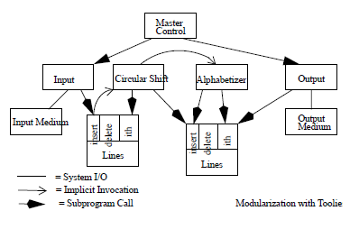
Event Driven
Drivers
The dependency between two components an observable and a subscriber is not known at design time, only at run time, and the two components must be connected by the running software.
The number of potential subscribers to the observable is more or less than one and that number needs to be determined dynamically.
The observable needs to notify the subscriber about periodic events, and for the subscriber to poll the observable is an inefficient use of threads.
Architectural Styles, Garlan and Shaw

Slide 43
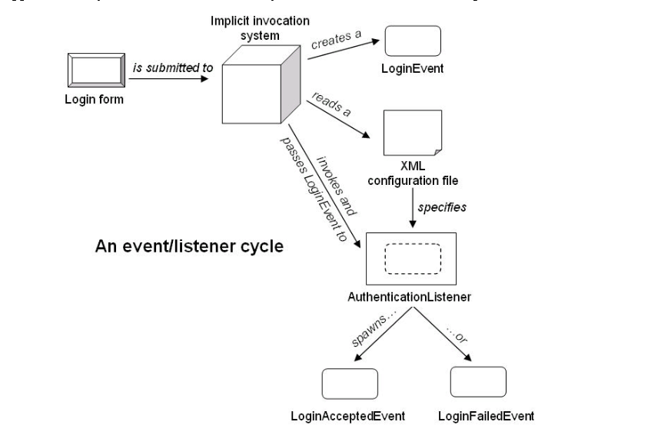
Event Driven
The components within this style are modules who can either (or both) provide events that observers can subscribe to by registering with them or register for notifications on an event from another component.
The connectors are bridge that allows the invocations of the subscribers function call by the originating modules when the conditions for the event transpire.
In essence this is a callback approach as outlined by the Observer design pattern as an architectural approach.
An event is a component. It is a type of message. Often it has a header with metadata and a body which describes what happened.
An Introduction to Implicit Invocation Architectures, Benjamin Edwards

Slide 44
Invariants
Properties
Publishers of events do not know which subscribers will be notified of those events
Components cannot make assumptions about ordering of events or which subscribers if any will respond to those events
It provides strong support for the Open-Closed Principle – open to extension, closed to modification – as new consumers of an event can be added without modifying the observable
It simplifies modification, new components can replace old ones, again without the observable being aware of the change in their subscription.
If components are executable then they can be distributed which allows for parallelizing their execution

Slide 45
Implementation
Decide how to transmit data when an event occurs
One model is to transmit the data with the event. One advantage of this approach is that the data is a snapshot of the data at the time of the event itself. However, it may involve considerable cost in obtaining and sending the data if we do not know if anyone will actually act on the event.
Another approach is to call back to the observable and ask it for the data when the event is processed. Whilst common there are some disadvantages, such as a naïve implementation fetching the data for every caller leading to load issues and in addition, in a distributed system, the subscriber relies on the observable being available to respond
Finally we can consider using a shared repository so that both subscriber and observable can query for the data. This can create coupling which is hard to see as there is no longer a direct call between the observable and the subscriber. In a distributed system we may try to get around this by building a query store for the subscriber to access, independent of the command store used by the observable.
Decide if it is necessary to support explicit invocation as well as implicit invocation
Because of the invariants around observables not knowing who subscribers are, of the ordering it may be necessary to supplement an event based model with explicit invocation.
Decide if this is a simple event architecture or a stream event architecture
In a simple event architecture all events are considered notable and sent to the consumer.
In a stream event architecture periodic events occur that may or may not be notable.
In a stream event architecture we may wish to filter events for their notability. This is done by the connector between the observable and subscriber and not by the endpoints. Often this uses a pipeline

Slide 46
Examples
Disadvantages
Model-View-Controller
IDE Debugging tools
Loss of control, what subscribers will be invoked, in what order, and are they done is unknown?
May be harder for developer to reason about cause and effect in the system because the event based style makes it hard to trace the path of execution.
Correctness is hard to prove: too much dependency on context and order of invocation. May lead to reduced testability.

Slide 47
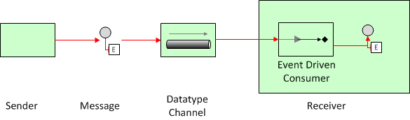
Simple Event Processing
Notes:
Simple Event Processing. In simple event processing, a notable event happens, initiating downstream action(s).

Slide 48
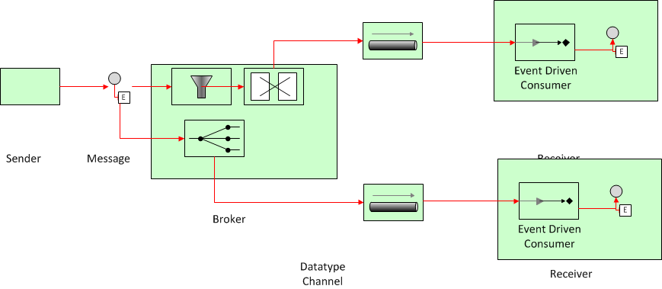
Stream Event Processing
Notes:
Stream Event Processing. In stream event processing, both ordinary and notable events happen. Ordinary events are both screened for notability and streamed to information subscribers. Simple event processing is commonly used to drive the real-time flow of work—taking lag time and cost out of a business.
Note that message filtering and translation, or message routing such as via a dynamic recipient list happen in the message pipeline, not as part of the receiver but between sender and receiver. The burden of event routing and redistribution is part of the event processing system not on the source. The source of the event just says: this happened regardless of how the event is used.
This is the common model that we see in Event-Driven SOA when we are signalling to interested services that something has happened within our

Slide 49
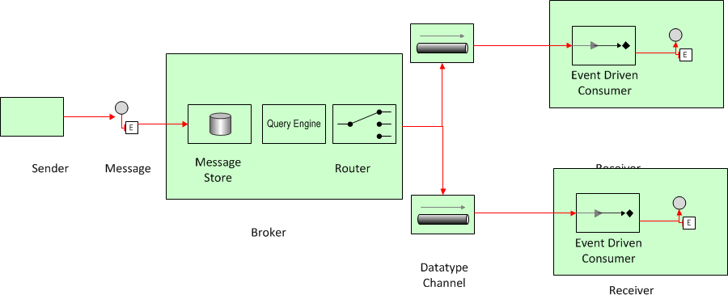
Complex Event Processing
Notes:
Complex Event Processing. Complex event processing (CEP) deals with evaluating a confluence of events and then taking action. The events (notable or ordinary) may cross event types and occur over a long period of time. The event correlation may be casual, temporal, or spatial. CEP requires the employment of sophisticated event interpreters, event-pattern definition and matching, and correlation techniques. CEP is commonly used to detect and respond to business anomalies, threats, and opportunities.
StreamingInsight from Microsoft is an example of a CEP tool

Slide 50
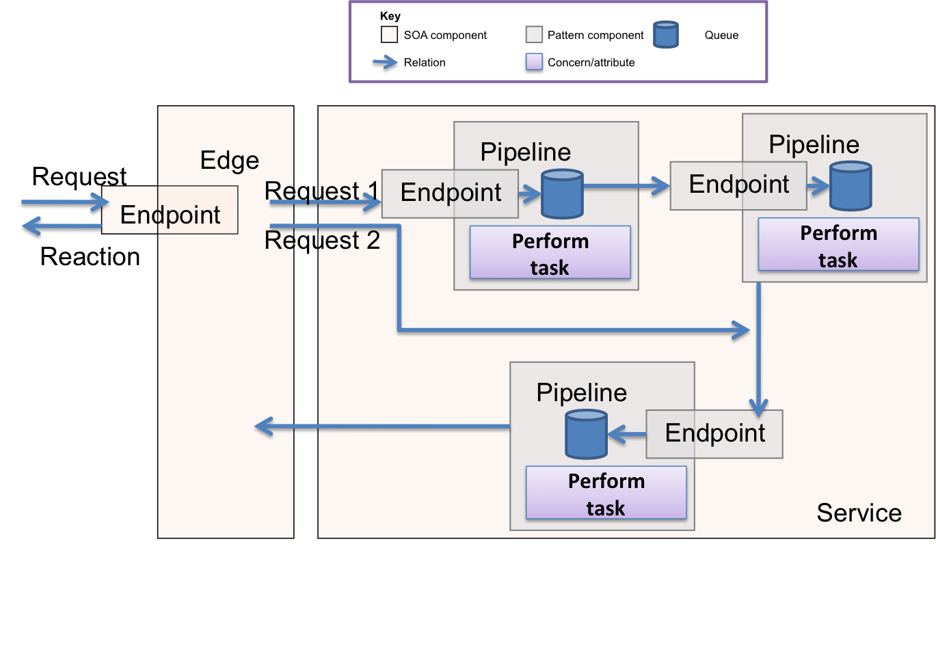
Staged Event Driven Architecture (SEDA)
Notes:
The Parallel Pipelines pattern, where you break the process into subtasks, add a queue between them, and make each subtask an independent component
The pipelines pattern is relatively simple to implement.
Pipelines are easy to test because they operate independently (you can test them with the same technologies and principles you use to test the services that include the pipelines).
Because the overall problem is broken into subtasks, each pipeline component tends to be simpler.
To scale the solution, you can distribute the pipeline across as many servers as needed.
When you need to scale the solution, the simplest option is to put each pipeline on its own server.
Events + Parallel Processing = Staged Event Driven Architecture or SEDA.

Slide 51
Demos

Slide 52
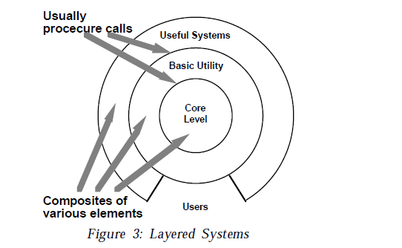
Layered Systems
Drivers
The major problem in software development is the management of complexity. Separation of concerns - the decomposition of the program into small components enables breaking a large complex system into simpler smaller ones.
Complex components may in turn require further decomposition.
Interfaces should be stable – they may even be an external contract for the system.
Changes to implementation details should not ripple through the system. Components should be replaceable with alternative implementations without affecting the rest of the system.
Similar responsibilities should have high cohesion – be grouped together – to aid reasoning about the software.
The dominant characteristic is a mix of higher and lower order operations, where high level operations depend on lower-level ones
Architectural Styles, Garlan and Shaw

Slide 53
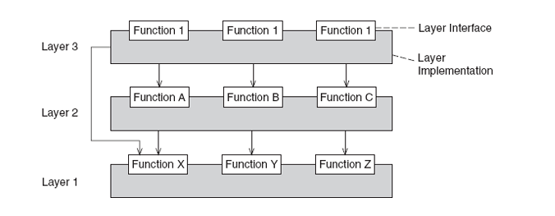
Layered Architecture
Components are the layers – a group of subtasks which implement an abstraction at some layer in the hierarchy.
Each layer provides services to the layer above it and acts as a client to the layer below.
The connectors are the protocols that define how the layers can interact.
Lower layers can pass data and service requests to higher layers via notifications (i.e. an observable)
POSA, 4th Volume

Slide 54
Invariants
Properties
Layers can only interact with adjacent layers.
A layer can provide services to a layer above, and consume services provided by the layer below.
A layer depends only on lower layers and has no knowledge of the higher layers.
The structure can be compared with a stack or onion.
Designs are based on increasing levels of abstraction. This allows portioning of a complex problem into a series of steps.
Changes to one layer impact at most two layers – below and above, supporting change.
Different implementations of the same layer can be reused interchangeably provided they support the same interface

Slide 55
Implementation
Define the abstraction criteria for grouping tasks into layers
The criteria is often the distance from the client with higher layers providing services to a user and lower levels dealing with the hardware
Determine the number of levels according to that criteria. Name those layers and assign tasks to them
Trade off between complexity of number of layers and the flexibility it provides
Again tasks that relate to the overall system as perceived by the client are in the highest layer, tasks that support that layer are in the next layer below and so on.
Specify an interface for each layer
We want to encapsulate knowledge about the layer from callers, because it supports modifiability. So we define an interface component to the layer, allowing ‘black-box’ use of that layer. This component provides a façade to the services of that layer. The black box may be ‘grey’ if we expose more than one façade component because the tasks provided by the service are orthogonal toe each other.
Specify the approach for communication between adjacent layers
Most commonly higher layers ‘push’ the data that lower levels need as part of the parameters to the call to that layer
However, sometimes a higher layer allows a lower layer to pull the information when desired, only providing a notification to the lower layer to pull on its own discretion.
If the higher layer provides notifications then the lower layer will need to use callbacks to call the higher layer, registering a subscriber with the higher layer to be notified when a change occurs.
Design an error-handling strategy
Either handle all errors within the layer or transform and pass to the higher layer
.

Slide 56
Examples
Disadvantages
Ports and Adapters (see below)
Not all systems are easily structured as layers
Performance considerations may require violation of layers and a closer coupling between higher and lower layers.

Slide 57
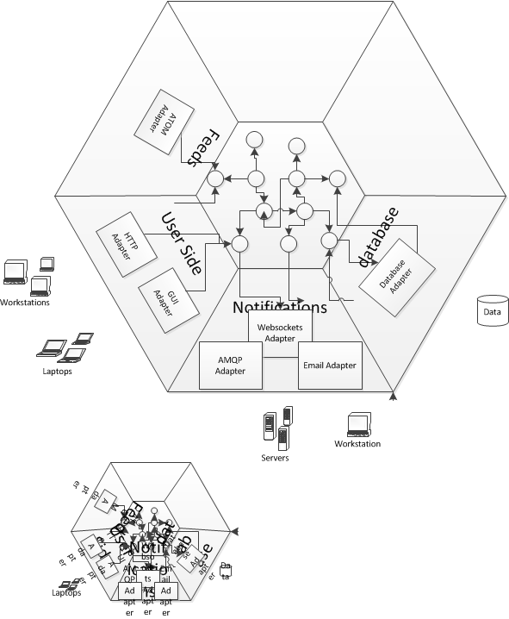
Ports and Adapters
A ports & adapters architectural style (Hexagonal Architecture) is a variation of the layered architectural style which makes clear the separation between the domain model - which contains the rules of our application - and the adapters, which abstract the inputs to the system and our outputs. The advantage of this style is that the application is decoupled from the nature of the input or output device, and any frameworks used to implement them.
For example when a client POSTs a request to the REST API exposed by our application the adapter receives the HTTP request, transforms it into a call onto our domain, and marshals the response back out to the client over HTTP. Similarly if our application needs to retrieve persisted entity state to initialise the domain it calls out to an adapter that wraps access to the Db.

Slide 58
Ports and Adapters
The layer between the adapter and the domain is identified as the Ports layer. Our domain is inside the port, adapters for external entities are on the outside of the port.
The notion of a 'port' invokes the OS idea that any device that adheres to a know protocol can be plugged into a port. Similarly, many adapters may use our ports.
A port is the 'use case boundary'. Use cases become problematic when they become focused on technology concerns. Use cases written against the ports can elide those concerns and focus on the application rules, making them easier to write and maintain.
There is a correlation here between the use case boundary and the test boundary - tests should focus on the behaviour expressed by a use case, not on a unit of code. Contrary to Cockburn, we don't suggest using a ATT like FIT or SpecFlow here, preferring to use our xUnit test tool here (and not test implementation details).
We have a notion of primary and secondary actors in use cases which map to the adapter and port layer. Primary actors exercise our application, they are inputs into our application. A primary actor uses a primary adapter, which calls a primary port - the chain is one of inputs into our application. So our REST API is a primary adapter, so are our tests. A secondary actor is one that our application exercises as part of its work, they are outputs from out application. So our Db is a secondary adapter, as our mocks and we talk to them over a secondary port. Many applications seem to consist only of one primary and one secondary, which leads to the n-tier style, but once we factor in tests we may begin to observe that we have more, and by building for multiple ports we make our application more modifiable to new ports in future.
We often show primary ports on the left and secondary ports on the right.

Slide 59
Implementing Ports
Service Facade
A Facade used in this context is being used in the Service role, where the Service stereotype describes an object that provides co-ordination and control logic.
One question is, how is our API provided? We are inside an adapter, so we might want to use a Plain Old C# Object (POCO) approach to avoid framework dependencies. A common route is to use the Facade pattern, providing a class that holds the API to lower level components. Indeed this is the classical implementation strategy for the application service layer in an layered architecture. The Facade design pattern provides a high-level interface to a sub-system, shielding the caller from the implementation details of the sub-system. This both reduces complexity for the caller, and decouples the caller from the implementation allowing us to vary it without amending the caller. To this extent it meets the needs of our port, providing a clear notion of outside - the caller and inside - the subsystem.
public class MyFatService
{
public void CreateMyThing(/* .. parameters ...*/)
{
/*Stuff*/
}
public void UpdateMyThingForFoo(/* .. parameters ...*/)
{
/*Other Stuff*/
}
public void UpdateMyThingForBar(/* .. parameters ...*/)
{
/*Other Stuff*/
}
/*Loads more of these*/
}
<code/>

Slide 60
Interface Segregation Principle
public interface ICreateMyThingService
{
void CreateMyThing(/* .. parameters ...*/);
}
public interface IUpdateMyThingForFooService
{
void UpdateMyThingForFoo(/* .. parameters ...*/);
}
public interface IUpdateMyThingForBarService
{
void UpdateMyThingForBar(/* .. parameters ...*/);
}
public class MyFatService : ICreateMyThingService, IUpdateMyThingForFooService, IUpdateMyThingForBarService
{
public void CreateMyThing(/* .. parameters ...*/)
{
/*Stuff*/
}
public void UpdateMyThingForFoo(/* .. parameters ...*/)
{
/*Other Stuff*/
}
public void UpdateMyThingForBar(/* .. parameters ...*/)
{
/*Other Stuff*/
}
/*Loads more of these*/
}
The Interface Segregation Principle states that clients should not be forced to depend on methods on an interface that they do not use. This is because we do not want to update the client because the interface changes to service other clients in a way that the client itself does not care about. An Transaction Script style port forces consumers (for example MVC controllers) to become dependent on methods on the domain service class that they do not consume.
Now this can be obviated by having the domain service implement a number of interfaces, and hand to its clients interfaces that only cover the concerns they have. With application service layers this naturally tends towards one method per interface.

Slide 61
Single Responsibility Principle
public interface ICreateMyThingService
{
void CreateMyThing(/* .. parameters ...*/);
}
public class CreateMyThingService : ICreateMyThingService
{
public void CreateMyThing(/* .. parameters ...*/)
{
/*Stuff */
}
}
public interface IUpdateMyThingForFooService
{
void UpdateMyThingForFoo(/* .. parameters ...*/);
}
public class UpdateMyThingForFooService : IUpdateMyThingForBarService
{
public void UpdateMyThingForBar(/* .. parameters ...*/)
{
/*Other Stuff*/
}
}
public interface IUpdateMyThingForFooService
{
void UpdateMyThingForBar(/* .. parameters ...*/);
}
public class UpdateMyThingForFooService : IUpdateMyThingForFooService
{
public void UpdateMyThingForFoo(/* .. parameters ...*/)
{
/*Other Stuff*/
}
}
Now the Single Responsibility Principle suggests that a class should have one and only one reason to change. All these separate interfaces begin to suggest that a separate class might be better for each interface, to avoid updating a class for concerns that it does not have. So we tend to move toward one class per API endpoint.

Slide 62
Command Design Pattern
The command design pattern encapsulates a request as an object, allowing reuse, queuing or logging of requests, or undoable operations. It also serves to decouple the implementation of the request from the requestor. The caller of a command object does not need to understand how the command is actioned, only that the command exists. When the caller and the implementer are decoupled it becomes easy to replace or refactor the implementation of the request, without impacting the caller - our system is more modifiable. Our ability to test the command in isolation of the caller - allows us to implement the ports and adapters model easily - we can instantiate the command, provide 'fake' parameters to it and confirm the results. We can also use the command from multiple callers, although this is not a differentiator from the service class approach.
In addition we can structure a system transaction ally using commands. A command is essentially a transactional boundary. Because a command is a transactional boundary, when using the Domain Driven Development technique of an aggregate there is a natural affinity between the command, which operates on a transactional boundary and the aggregate which is a transactional boundary within the domain model. The aggregate is the Receiver stereotype within the Command Design pattern. Because we want to separate use of outgoing adapters via a secondary port, such as a Repository in the DDD case, this can lead to a pattern for implementation of a command:
1: Begin Transaction
2: Load from Repository
3: Operate on Aggregate
4: Flush to Repository
5: Commit Transaction
In the Repository pattern we may need to notify other aggregates that can be eventually consistent of the change within the transaction ally consistent boundary. The pattern suggested there is a notification. Because the handling of that notification is in itself likely to be a transactional boundary for a different aggregate we can encapsulate this domain event with the Command design pattern as well, which gives rise to the following additional step to the sequence, outside the original transactional boundary:
6: Invoke Command Encapsulating Notification

Slide 63
Implementing a Command
From our perspective, the single method API endpoints are in fact commands. We could rewrite
public class UpdateMyThingForFooinService : IUpdateMyThingForFooinService
{
public void UpdateMyThingForFoo(/* .. parameters ...*/)
{
/*Other Stuff*/
}
}
using an interface to represent a command as
public interface IAmACommand
{
void Execute();
}
public class UpdateMyThingForFooFooCommand
{
public UpdateMyThingForFooCommand(/* .. parameters ...*/)
{
/* Initialize state of command for members */
}
public void Execute()
{
/*Other Stuff*/
}
}
Implementing the pattern is simple, we implement a command interface, that has a method to execute the command. We then create a concrete instance of the command that derives from this interface. The invoking class executes the command without being directly coupled to the receiver which the command uses to implement the action requested.

Slide 64
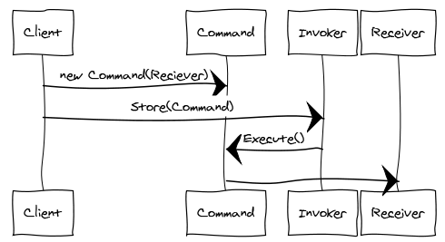
Command Sequence Diagram
An Invoker object stores the concrete Command object.
The invoker issues a request by calling Execute on the command. When commands are un-doable, the Command stores state for undoing the command prior to invoking Execute.
The Command object invokes operations on its receiver to carry out the request

Slide 65

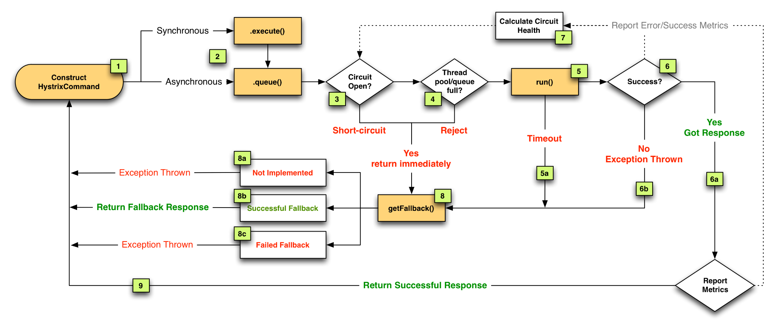
Example

Slide 66
Macro Command
A Macro command is a command that consists of other commands. At its simplest form this is just a class that contains a list of commands to execute in sequence. A Macro Command has no Receiver, because each Command in the list has its own Receiver

Slide 67
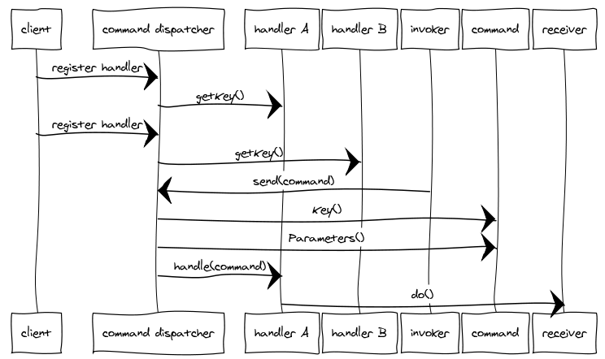
Command Dispatcher
To decouple a higher and lower layers we want to be able alter the implementation of the commands that we call on the lower layer without altering the calling layer.
We want to separate an Action-Request object that contains the identity of the action we want to perform, and the parameter for that action from the Action-Handler which knows how to perform that action.
A Command Dispatcher is an object that links the Action-Request with the appropriate Action-Handler.
We may distinguish between a Command Action-Request that has one Action Handler and an Event Action-Request that has many

Slide 68
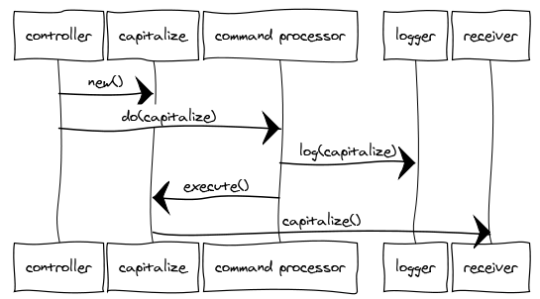
Command Processor
The Command Processor pattern provides details of how to manage a set of commands used to separate the request for service from its execution.
The Command Processor accepts requests for Commands, schedules and executes them, manages their history (such as storing for later undo or replay) and performs any other orthogonal housekeeping operations. The client is decoupled from the responsibilities of managing and scheduling commands.
A Command Processor enforces quality of service and maximizes throughput.
A Command Processor forms a juncture at which concerns like: retry, timeout and circuit breaker can be implemented for all commands.

Slide 69
Demo
Paramore.Brighter

Slide 70
CQRS
Drivers
A read heavy system processes far more transactions reading data from a repository than writing them.
In a complex domain model it can be difficult to optimize for performance of the read model at the same time as the write model.
When the data access layer has complexity to page results or pre-fetch associated entities (eager load) it is hard to reason about the complex domain model. Writing queries and a simpler model would help that elides some of that complexity.
The use of DTOs to simplify for ‘on glass’ results in violations of information hiding for domain objects, just to allow them to be displayed.
Where the read model can be much simpler than the write model, because we don’t have to worry about transactional boundaries such as aggregates, or retrieve less data (such as an Id and Description).
On the write side we want to store data in a 3rd normal form, but on the read side we could choose to reduce joins by using 1st normal form.
On the write side we want consistency, to avoid having to resolve conflicting updates (CA), but on the read side we may accept eventual consistency (AP)
Where the domain logic: validation, algorithms, invariants and derivations applies differently to writes and reads .
Often the read model only has derivations (looking up facts from knowledge we already have).

Slide 71
Presentation
GET a page of data
Bind DTOs to view
POST change to data
Application
Query entities via ORM
Turn entities to DTOs
Query entities via ORM
Update entities
Persist changes via ORM
Domain
Turn rows to entities
Turn rows to entities
Infrastructure
DB

Slide 72
Presentation
GET data for view
Thin Read
Application
Populate View-Model
Domain
Infrastructure
DB

Slide 73
Presentation
POST command
Thin Read
Application
Call method on domain
Get Aggregate
Domain
Infrastructure
DB

Slide 74
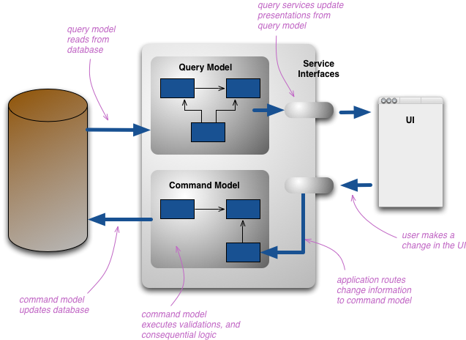
Command Query Separation
Components are either query-side components or command-side components.
The path of a request through the system only passes through command-side or query-side components depending on whether it is querying or modifying the state of the system.
Only command-side components can update a repository, query-side components just read from it.
Commands and queries are usually explicit components on their respective sides.
Both the command-side and the query-side are layered, but there are usually far fewer layers on the query-side.
Commonly the command-side components are a domain model, though other styles such as procedural are not forbidden.
The query-side components might be elevated to a domain model, but are normally just procedural.
Martin Fowler, http://martinfowler.com/bliki/CQRS.html

Slide 75
Invariants
Properties
Components must either be command-side components or query-side components
Only command-side components can update the repository; query-side components may only read from the repository
It is easier to reason about a complex domain model when command-side operations are separated from query-side operations. The two concerns are frequently orthogonal and cloud each other.
It is easier to optimize performance for commands and queries separately, given that they have different use cases. It is also easier to scale the query-side separately from the command-side

Slide 76
Implementation
Divide the system into read and write bounded contexts
Each bounded context has its own ubiquitous language and thus domain model.
The query side model may actually only be procedural and not a full domain model
Within each context we optimize the model either for commands or for queries. For example the command side can eager load, does not have to worry about paging etc. We can also reduce our use of public getter attributes on command side entities as we do not need to report on state and so preserve information hiding.
Of course the ‘command’ context still has to read before an update so that we know what we are updating, and confirm concurrency etc. This is really a command-optimized read context
It’s important to observe that the query side should never update the repository
Decide whether to surface commands at the service layer or port
We may choose to explicitly surface the idea of a command in the model on the write side model, by using the Command pattern, particularly if we are using a Task-based UI due to the inherent fit in the ubiquitous language with the ‘command side ‘
This is particularly important if we intend to support event sourcing on the command-side
Surface a ‘thin read layer’ model for queries
The thin read model is about supporting specific queries only. It is a thin wrapper over calls to the repository that is often optimized for the performance and scalability attributes over modifiability.
It may rely on implementation specific properties of the repository such as stored procedures to meet those quality attributes
Decide on the integration strategy between the two bounded contexts
At the simplest level we can have a shared kernel approach to integration and have both the query and command model use the same underlying schema. This means they must remain within the same Continuous Integration Boundary, and is thus only suitable for one team. Although the schema is shared, we may use a master-slave pattern between the command and query store to distribute our load.
If the query schema differs from the command schema we have can still use a shared kernel provided we can use views to layer our query model over our command model.
It may not be possible to build an optimized query model from the command schema through the use of views, in this case we need to asynchronously build the query model from the command model. Usually we do this in a batch-sequential style, raising a notification from the command model whenever a change is made that we use to build out the query model
Event Sourcing is one mechanism for synchronizing the command and query models.
Command-Query Separation is the application of the OO idiom of Command and Query Separation as an architectural style.
In Command-Query Separation a method on an object may either mutate its state (preserving invariants) or retrieve it’s state but not both. Such methods are said to be ‘side-effect free’
As an architectural style the principle extends to separate commands and queries so that each model is ‘side-effect free’

Slide 77
Examples
Disadvantages
Some developers find it hard to reason about a system when it is separated in this fashion, constantly applying boundaries from the command model on the query model. This may make it harder to achieve query model benefits
The query model can be harder to maintain when divorced from the command model. As changes to the command model need to propagate to the query model to be visible updating or refactoring the command model may now involve some ‘shotgun surgery’ to update the query model.

Slide 78
Demos
Paramore.Rewind

Slide 79
Distributed processes

Slide 80
Broker
Drivers
Client-Server
Application code should not need to address the complexities of distribution.
The infrastructure used to send messages between local and remote components should be transparent in that the architecture should make invoking methods on remote components as simple as invoking them on local components.
Senders should not need to know about the location of receivers.
Senders should not know how to marshal requests to receivers.
In essence this is a specialization of the client-server architectural style; it deals more specifically with how the client and server components connect so as to elide them out of application code. We don’t cover client-server separately because it’s essentially covered here.

Slide 81
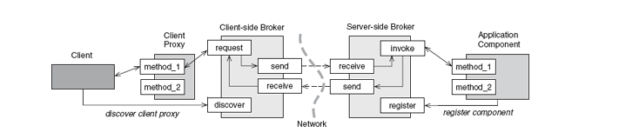
Distributed Processes
Components are independent processes.
A requestor component forwards messages from the sender to the receiver.
An invoker component dispatches requests from the broker to the receiver component.
A message component usually has a header with metadata such as id and timestamp, and a body with the specific information communicated to the receiver.
The connector is infrastructure, usually some form of middleware.
A client proxy component provides a copy of the receivers interface to the client which can be used to structure messages to the receiver via the broker
POSA, 4th Volume

Slide 82
Invariants
Properties
The only means of information exchange between components is message passing. There is no shared repository or data structure.
The components are autonomous – they do not control each other; the sender cannot decide what action the receiver will take or if it will take it. If multiple receivers respond to a message the client has no control over their ordering.
It complies with the Open-Closed Principle – it is open to extension by adding new consumers but does not require modification as the sender is unaware of receivers.
It provides support for modifiability – a remote component can be replaced without the sender knowing.

Slide 83
Implementation
Decide on a request-reply, request-reaction, and inversion of communication
See subsequent slides for diagrams…
Request/Reply is the easiest programming model to understand, the sender makes a synchronous call to the receiver component, but also is the one most at odds with the reality of the cost of remote calls
Request/Reaction takes into account the cost of making a remote call but suffers from forcing knowledge of the location of receiver onto the sender
Inversion of Control avoids problems with the sender waiting for a response from the receiver but has the most complex model to reason about. Inversion of Control may lead to use of the Saga pattern to manage distributed transactions.
Decide on middleware to be used for the connectors
The choice is essentially between RPC-style middleware (CORBA, COM, WCF, Thrift) and between Message Oriented Middleware (AMQP, ZMTP, et al).
Messaging has the advantage of being loosely coupled, the sender has no knowledge of how the receiver will respond to the request. This makes the system amenable to change.
You can drop down as far as something like sockets to do this, but the reason all those protocols exist on top of sockets is that this shifts a considerable burden onto the implementer of the broker that these other protocols have already tackled.
Implement requestor and invoker
Many RPC frameworks reduce the burden here considerably by providing the requestor and invoker framework and handling concerns such as lifetime of the invoked receiving component, although this may require some additional code. For example in .NET SOAP based web services are defined by WSDL and tooling can be used to generate a client-proxy component that marshals a call to a remote component (a requestor) whilst server side we services can be configured with attribute based mark-up. With message oriented middleware only the messaging API itself tends to be provided and implementers need to provide support for Invoker and Requestor. However a number of .NET OSS libraries such as NServiceBus, MassTransit, Fubu, and Paramore.Brighter do provide this functionality to varying degrees.
Conceptually building a distributed infrastructure is a simple as installing your choice middleware and getting both sender and receiver to talk to it. This elides a fair amount of complexity though, not only in the APIs for the middleware, which may themselves be complex, but in managing those calls reliably. As the remote call is expensive in time and may best be handled asynchronously leading to a different programming model on the client. Both distribution and parallelism are complexity and so distribution has to be justified by needs of the application.

Slide 84
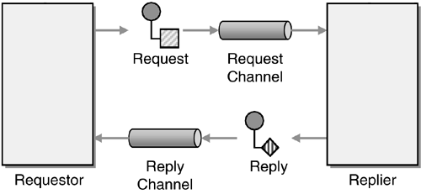
Request-Reply
Enterprise Integration Patterns, Gregor Hope
Notes:
Request-Reply has two channels: a request channel and a reply channel and a pair of messages a request and a response.
The request is a command message – it asks for something, it is imperative
The response is a document message – it contains information about the result of the request: result code, return value
The requestor sends the message and waits for the response. The replier returns the response to the requestor.
Easy in a shared memory space, it becomes a little more complicated in an SOA where the requestor and replier are in separate processes.
The requestor has a blocking approach the requesting thread and waits for the reply by polling – this is simple but prevents other work from happening while waiting on the replier.
Request-Reply is used for RPC (the command invokes a method, the result is in the document) querying (the command describes the query, the response the result set), or notification (the event describes what happened, the document returns an acknowledgement, perhaps with a request for more information).
RPC can be highly-coupled – the requestor knows details of the replier’s implementation (SOAP suffers from this). Avoid this issue by using a document-centric approach, that is the command should tell the replier what the requestor wants, not how the replier should fulfill the contract.
Both the request and the reply message schemas are owned by the replier not the requestor
Request-Reply is mainly used for the its simplicity of its interaction style – ask a question get an answer. It is simple for the consumer to handle. And a lot of the time it is all you need. SOAP and REST are examples of this request-reply approach. It is a low complexity pattern and don’t increase complexity without necessity.
Note that the request channel might be a direct channel but it equally might be a publish-subscribe channel. It doesn’t make sense to reply to many people, but it might make sense to publish to many people - although its common for this to be fire-and-forget now wait for a reply.

Slide 85
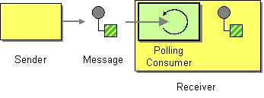
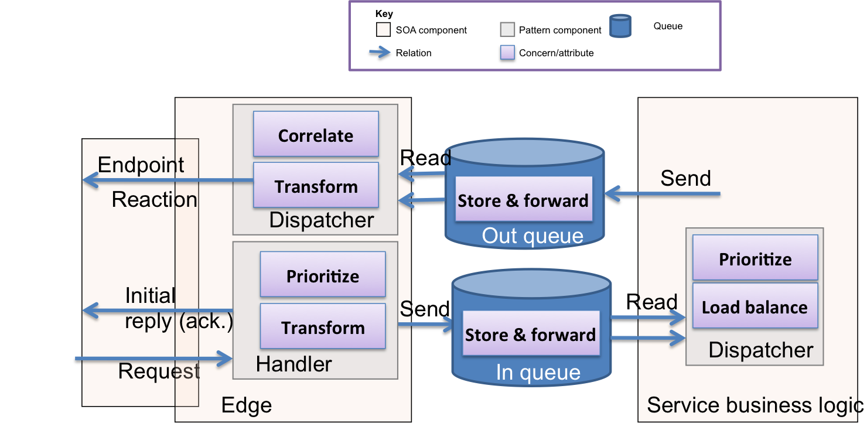

Request-Reaction
SOA Patterns, Arnon Rotem-Gal-Oz
Enterprise Integration Patterns, Gregor Hope
Notes:
The problem with the request-reply pattern is that the requestor ties up resources waiting for the replier to respond. This is especially problematic because the replier might be on a different machine.
What we want to do is acknowledge the receipt of the request – with an indicator of when we expect the request to be done and let the requestor go about its business. Then we send the requestor the response when we are done. On the server we often use a decoupled invocation pattern – that is we put the request on a queue, from the edge (essentially the adapter in a ports & adapters view of architecture – our port is an asynchronous not a synchronous one), acknowledge and then consume events from the queue when we have capacity. The use of a queue means that we do not lose requests, such as under load, and helps a service scale without needing to add additional servers. We may couple with this pipeline processing for a complicated business process.
On the client there are two ways to solve waiting for the response from the server. Push to an event driven consumer, or polling by the client to fake push
Polling
With request-reaction timing becomes an issue. It might be seconds before a reply happens, but it might be days. So giving some indication of when you should call back becomes significant. The requestor spins off a separate thread to poll for the reply, which also contains the context of the call when the reply is received. The same thread and channel can be used to wait for a number of messages, making more efficient use of resources which scales better. This is a ‘push’ approach, because we push the messages back to the caller. The caller still needs to poll on a thread to check for a reply (even if it is under the hood).
Examples of this are returning a 202 Accepted and providing a resource to poll in the location header, Long-polling (keeping the connection open instead of closing it)
Push
Better than this is push: Sockets/Websockets, SendEvents, HTTP Streaming, Pushlets, XMPP, or using MOM for each channel. Push removes temporal coupling – you no longer create a dependency on when you call. Push is the model that makes sense when you need to be asynchronous and not synchronous.
The downside is that you abandon control of message ordering – so now you need to be idempotent or figure out sequence and re-sequence if required. Correlation can help significantly – the request has a unique id, the response returns it to allow the requestor to match the response to its request.

Slide 86
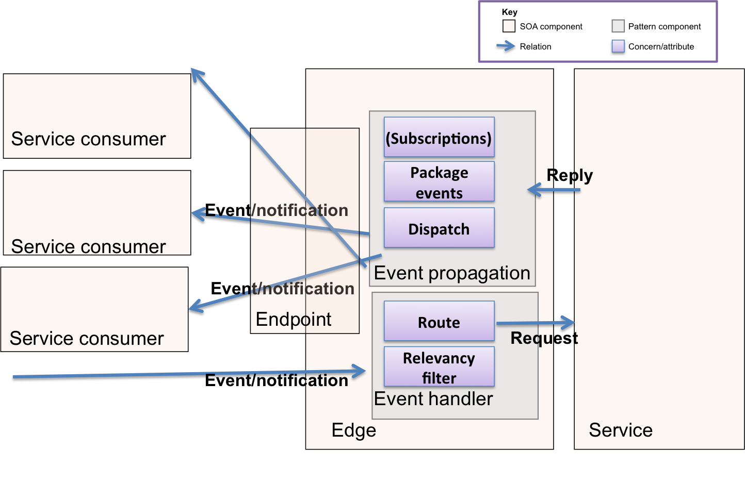
Inversion of Communication
SOA Patterns, Arnon Rotem-Gal-Oz
Notes:
If I want two services to communicate about an event – something that has occurred in one service that another might wish to take action in response to I have several options.
To explain let’s take a classic example, that of an hotel reservation system.
The first is for the originating service – the event producer – to send a message to all interested parties by calling an interface that the receiver exposes. The problem here is that it introduces coupling between the event producer and consumer. Why does the producer need to care about the details of the consumer of the event.
In our example when a reservation is made there may be a number of services that want to know when a new reservation is made: billing to take a payment, housekeeping to let them know the room will be occupied and need cleaning, maintenance to fix any defects etc. If the reservation system knows details of interfaces for all of these services, it has to change when one of them changes – an expensive proposition and a problem of coupling.
An alternative is for the interested consumers to poll the producer, asking for new information. This creates the correct dependency direction – consumers now depend on the producer and we only need to change the consumers if the producer wants to change what it notifies the consumers of. The producer could for example expose an RSS feed of events and consumers poll them. The problem here is the polling interval – too short and the load becomes an issue, too long and important events may be dealt with too slowly.
So in our example the housekeeping system could poll the reservation system to find any new reservations and prepare the room. But the interval needs some thought – reservations may not change much day-by-day but housekeeping needs to be able to react to on the spot reservations or we lose business.
Another option is to externalize the relationship via a workflow service – the producer raises the event to the workflow service, which in turn forwards the message to interested parties. This can allow you to alleviate coupling issues, by pushing responsibility for message transformation and routing out to the workflow service. The problem though is that these workflow services have a tendency to decline into hard to maintain spaghetti once complexity increases. Above 4-5 connections, workflow increasingly becomes the weak point in inter-service communication.
The optimal solution is to combine SOA with Event Driven Architecture (EDA). A service publishes a stream of events to interested parties. Instead of a consumer reaching out and polling for updates, the service publishes the event to interested parties. The event has schema, but we do not couple to a unique interface on the consumer, instead the consumer simply accepts messages of the schema defined by the originator. So we do not couple to a client interface nor do we force consumers to poll.
The inversion of communication pattern does not talk about subscription management being part of the service edge (how a service interacts). This is because subscription management requires effort that does not relate to services and is usually best handled by messaging infrastructure using the Dynamic Recipient List pattern that allows consumers to register for topics that they are interested in subscribing to. Dynamic registration has the advantage that we can add new consumers without modifying the originator
The downside to inversion of communications is the increase in complexity. It can be harder to understand the flow of control in the system, because an event may trigger a series of reactions that are not obvious to the producer – there is no easy way to see who is registered if we allow dynamic registration – so understanding the behavior of the system is difficult, One trick here is to rely on the fact that services are boundaries is to not worry what happens beyond that boundary, simply test the contract at the boundary and assume the other services worry about their own boundaries. The downside is confidence in any MOM, but this can be tested in isolation.

Slide 87
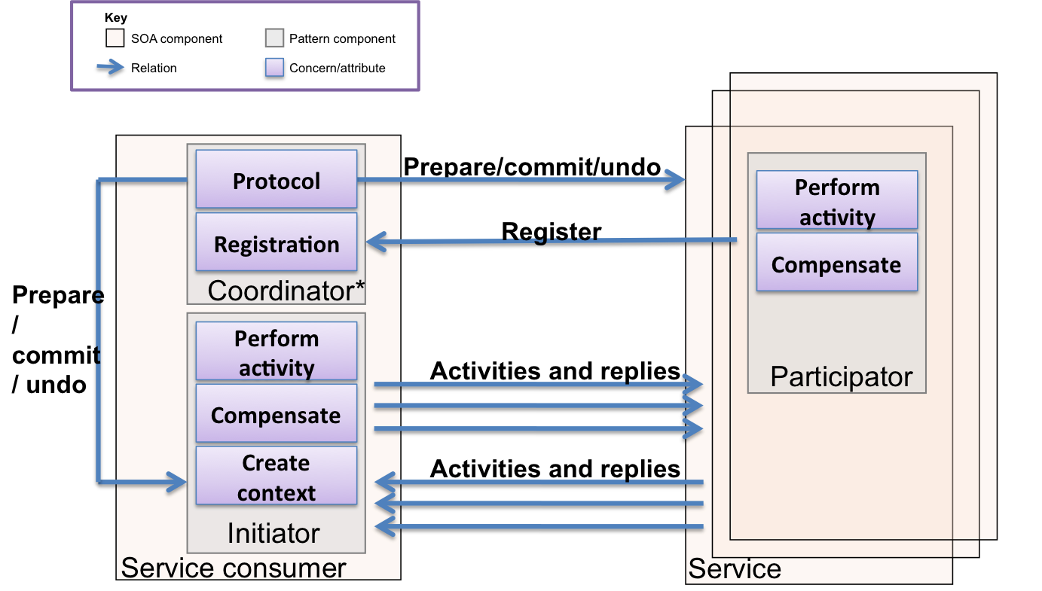
Saga
SOA Patterns, Arnon Rotem-Gal-Oz
Notes:
Processing may require us to deal with a series of steps. Consider our example of a system that takes hotel reservations. The reservation system takes the customer request and raises a ReservationMade Event. The Event contains details of the Reservation, that might be needed by other systems, it is a document message. Billing subscribes to ReservationMade, caches the billing information for the customer and takes the payment. Once the payment is confirmed by the credit card company it raises a ReservationPaid event. The Housekeeping service waits for the ReservationPaid to allocate a room and cache details of who will be in the room on a given date range.
If we try to hold a transaction across the lifetime of this work then we tie up resources for a long-running operation. This will not scale as other requests will deadlock waiting for this request to fail. So we have a rule that we only want to use a transaction within the service boundary in an event handler.
But let’s assume that since the customer began the ordering process the Maintenance service indicates that the room is now out of action and the hotel is full. We now have a problem. Because we were not transactional, we cannot guarantee that the room will be available post-Billing. We could alternatively allocate the room and then take the money. This prevents rejection of a booking, but means we could lose business if someone could not book because the hotel was full, which is another problem.
Note that this is a business problem – in that the business needs to understand the kind of compensation to take. This act of allowing individual transactions to occur, and then compensating for them is called a saga. We might decide to cancel the booking and refund the customer their money, we might rebook in a partner hotel instead.
You can implement a saga either internally – each service simply raises exception events and expects other services, who know how to compensate, to initiate a new sequence. So for example the Housekeeping service might raise a NoRoomsToAllocate event with the Id of the reservation that it was rejecting. The alternative is to manage the saga externally in a process that listens for completion events, often within a timeout for a whole sequence of messages and raises a timeout if that does not occur.
The tradeoff here is between the lower coupling of services just raising failure events, and the maintainability of having a single place where the steps in the transaction are identified.

Slide 88
Examples
Disadvantages
CORBA
DCOM
.NET Remoting
AMQP
ZMTP
It can be harder for developers to debug applications which cross a remoting boundary leading to increased development complexity.
It can be more difficult for developers to reason about software when they cannot trace the path of execution through the code as at a given point it branches to a remote component.
Calls across the network are subject to the fallacies of distributed computing.
Availability via redundancy may be straightforward

Slide 89
Demos
Paramore.Brighter

Slide 90
Demos
Paramore.Rewind

Slide 91
Wrap up

Slide 92
Further Reading
Software Architecture, Mary Shaw & David Garlan
Candidate Model Problems in Software Architecture, Shaw Garlan et al.
Software Design Methodology, Hong Zhu
An Introduction to Implicit Invocation Architectures, Benjamin Edwards
Hexagonal Architecture, Alistair Cockburn
CQRS, Greg Young
CQRS, Martin Fowler
SOA Patterns, Arnon Rotem-Gal-Oz
Enterprise Integration Patterns, Gregor Hohpe

